Slide 1
计算机组成原理
---双语教学课件
计算机与通信学院
任学惠

Slide 2
William Stallings
Computer Organization and Architecture
6th Edition
Chapter 5
Internal Memory

Slide 3
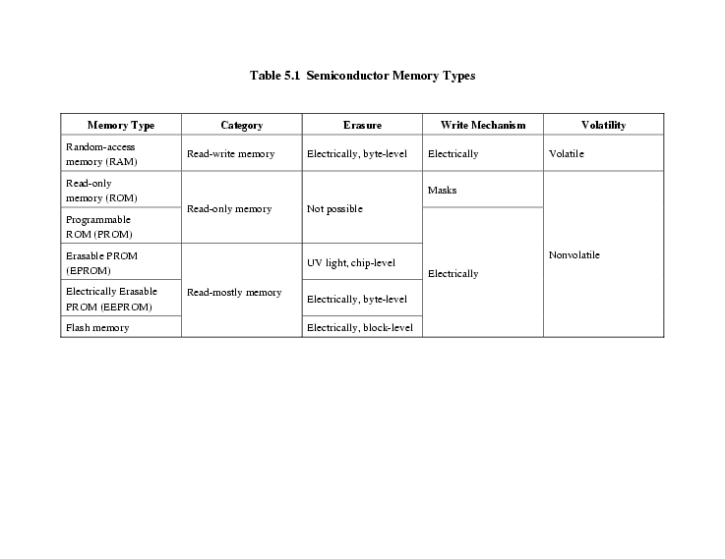
Semiconductor Memory Types page140

Slide 4
Semiconductor Memory
RAM
  Misnamed as all semiconductor memory is random access
  Both Read/Write
  Volatile (power support)
  Temporary storage
  Static or dynamic

Slide 5
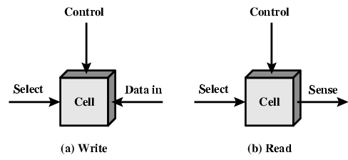
Memory Cell Operation

Slide 6
Dynamic RAM
Bits stored as charge in capacitors
Charges leak
Need refreshing even when powered
Simpler construction
Smaller per bit
Less expensive
Need refresh circuits
Slower
Main memory
Essentially analogue
  Level of charge determines value

Slide 7
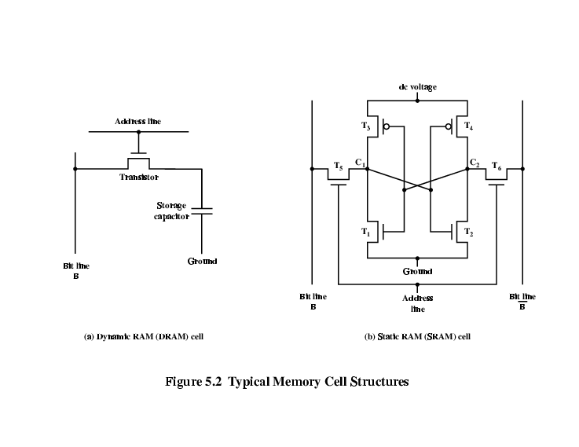
Dynamic RAM Structure
gate
recharge

Slide 8
DRAM Operation
Address line active when bit read or written
  Transistor switch closed (current flows)
Write
  Voltage to bit line
    High for 1 low for 0
  Then signal address line
    Transfers charge to capacitor

Slide 9
Read
  Address line selected
    transistor turns on
  Charge from capacitor fed via bit line to sense amplifier
    Compares with reference value to determine 0 or 1
  Capacitor charge must be restored
  recharge

Slide 10
Static RAM
Bits stored as on/off switches
No charges to leak
No refreshing needed when powered
More complex construction
Larger per bit
More expensive
Does not need refresh circuits
Faster
Cache
Digital
  Uses flip-flops

Slide 11
Stating RAM Structure

Slide 12
Static RAM Operation
Transistor arrangement gives stable logic state
State 1
  C₁ high, C₂ low
  T₁ T₄ off, T₂ T₃ on
State 0
  C₂ high, C₁ low
  T₂ T₃ off, T₁ T₄ on
Address line transistors T₅ T₆ is switch
Write – apply value to B & compliment to B
Read – value is on line B

Slide 13
SRAM v DRAM
Both volatile
  Power needed to preserve data
Dynamic cell
  Simpler to build, smaller
  More dense
  Less expensive
  Needs refresh
  Larger memory units
Static
  Faster
  Cache

Slide 14
Read Only Memory (ROM)
Permanent storage
  Nonvolatile
Microprogramming (see later)
Library subroutines
Systems programs (BIOS)
Function tables

Slide 15
Types of ROM
Written during manufacture
  Very expensive for small runs
Programmable (once)
  PROM
  Needs special equipment to program
Read “mostly”
  Erasable Programmable (EPROM)
    Erased by UV
  Electrically Erasable (EEPROM)
    Takes much longer to write than read
  Flash memory
    Erase whole memory electrically

Slide 16
Organisation in detail
A 16Mbit chip can be organised as 1M of 16 bit words
A bit per chip system has 16 lots of 1Mbit chip with bit 1 of each word in chip 1 and so on
A 16Mbit chip can be organised as a 2048 x 2048 x 4bit array
  Reduces number of address pins
    Multiplex row address and column address
    11 pins to address (2¹¹=2048)
    Adding one more pin doubles range of values so x4 capacity

Slide 17
Refreshing
Refresh circuit included on chip
Disable chip
Count through rows
Read & Write back
Takes time
Slows down apparent performance

Slide 18
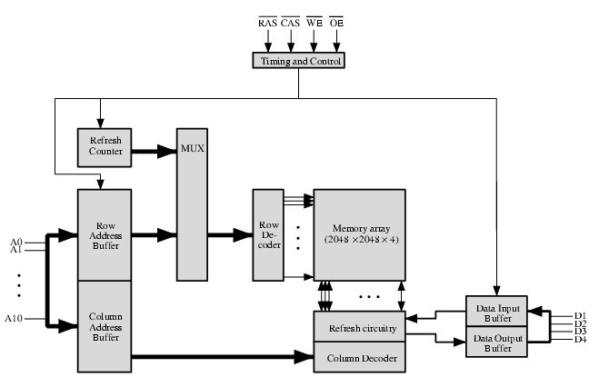
Typical 16 Mb DRAM (4M x 4)

Slide 19
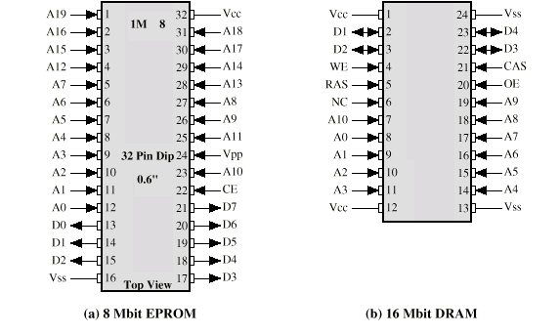
Packaging

Slide 20
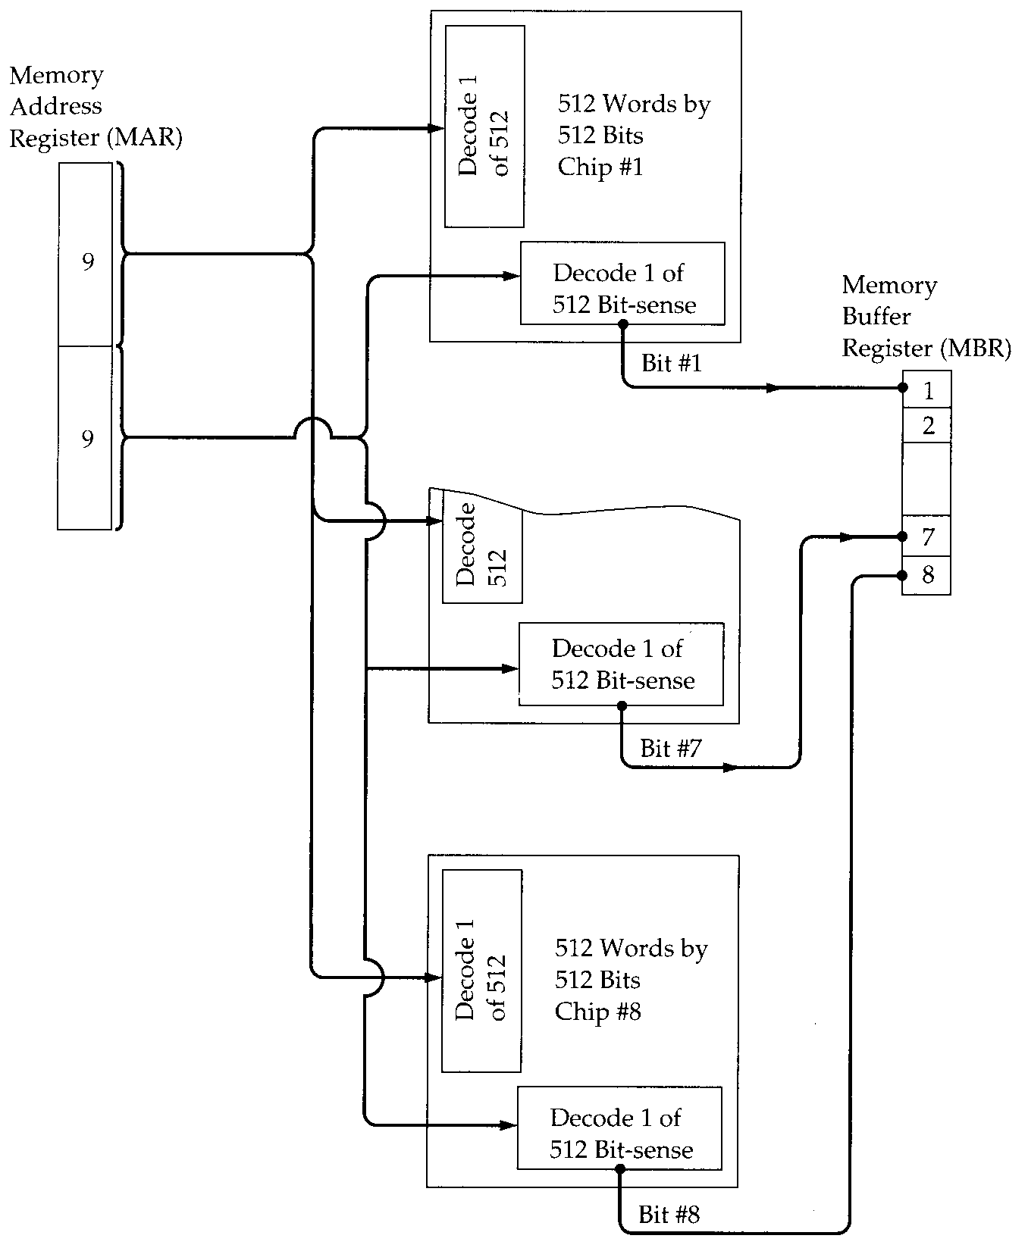
Module
Organisation

Slide 21
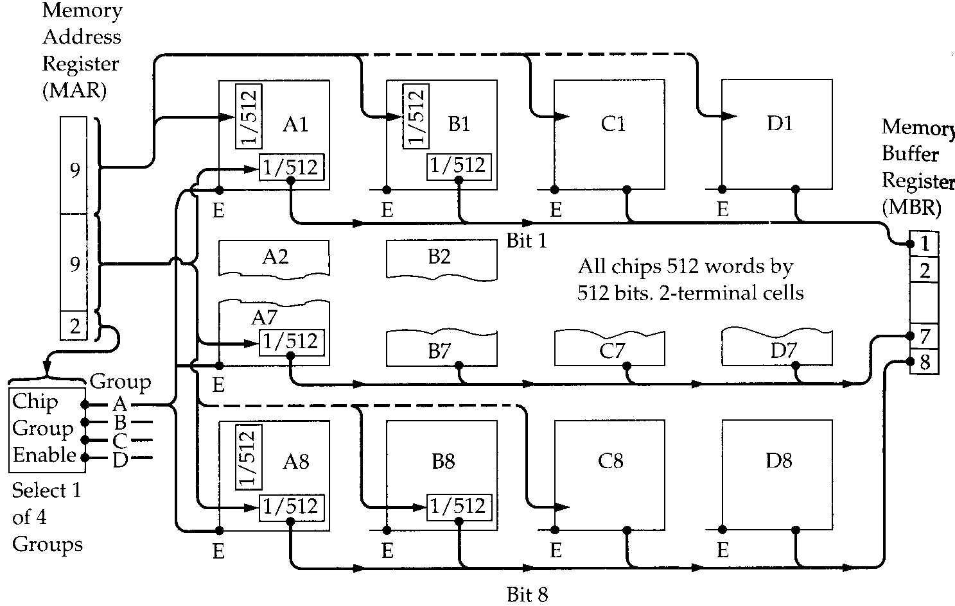
Module Organisation (2)

Slide 22
Error Correction page 148
Hard Failure
  Permanent defect
Soft Error
  Random, non-destructive
  No permanent damage to memory
Detected using Hamming error correcting code

Slide 23
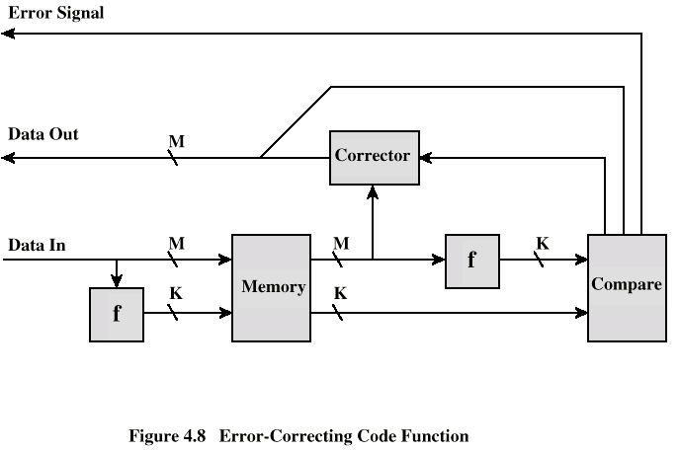
Error Correcting Code Function page 149

Slide 24
Hamming code(1)
Error Correcting Code
  Can detect an error and correct it
2^{k}>m+k
  m bit data code(8, 16, 32 ,……)
  k bit check code (addition for correcting error)

Slide 25
Hamming code (2)
Word length with increase for error correction
Data bit | Check bit | %Increase
8 | 4 | 50
16 | 5 | 31.25
32 | 6 | 18.75
64 | 7 | 10.94
128 | 8 | 6.25
256 | 9 | 3.52

Slide 26
Hamming code (3)
Position Code |  | Check bit | Data bit
12 | 1100 |  | m8
11 | 1011 |  | m7
10 | 1010 |  | m6
9 | 1001 |  | m5
8 | 1000 | c8
7 | 0111 |  | m4
6 | 0110 |  | m3
5 | 0101 |  | m2
4 | 0100 | c4
3 | 0011 |  | m1
2 | 0010 | c2
1 | 0001 | c1
When m=8
k=4
Arrangement
data bit &
syndrome bit
真值表

Slide 27
Hamming code (4)
Make out the relationship of correct bit with data bit
C1=m1⊕m2⊕m4⊕m5⊕ m7
C2=m1⊕m3⊕m4⊕m6⊕m7
C3=m2⊕m3⊕m4⊕m8
C4=m5⊕m6⊕m7⊕m8

Slide 28
Error Correcting Code Function page 149

Slide 29
Hamming code (5)
According data bit , calculate correct bit
Store m-bit data & k-bit correct bit
……….
When fetch the data , Re-calculate correct bit according data bit (data may have an error)
C1’=m1⊕m2⊕m4⊕m5⊕ m7
C2’=m1⊕m3⊕m4⊕m6⊕m7
C4’=m2⊕m3⊕m4⊕m8
C8’=m5⊕m6⊕m7⊕m8

Slide 30
Error Correcting Code Function page 149

Slide 31
Hamming code (6)
Makes the syndrome word
Old correct bit c8 c4 c2 c1
New correct bit ⊕c8’ c4’ c2’ c1’
Syndrome word X X X X
The syndrome word is error position code

Slide 32
Error Correcting Code Function page 149
new
old

Slide 33
Hamming code (7)
If syndrome contains all 0s , no error , the data is REAL ①
If syndrome contains one & only one 1 , the old correct bit is error , but the data is REAL ②
If syndrome contains more than one 1s, the syndrome value indicates the position of error bit , correct the bit ③
But syndrome value larger than 12, more than one error occurs ④

Slide 34
Error Correcting Code Function page 149
④
①②
③

Slide 35
Hamming code (8)
E.g. data is 0011 1001
Calculates old correct bit:
C1(1,2,4,5,7)=1⊕0⊕1⊕1⊕0=1
C2(1,3,4,6,7)=1⊕0⊕1⊕1⊕0=1
C4(2,3,4,8) =0⊕0⊕1⊕0 =1
C8(5,6,7,8) =1⊕1⊕0⊕0 = 0
Stores (m+k)data & correct bit:
0011 0 100 1 1 1 1

Slide 36
Hamming code (9)
Suppose data bit m3 is changed from 0 to 1 in storage. 0011 0 110 1 1 1 1
…..
When fetches the data , Re-calculates new correct bit :
C1’(1,2,4,5,7)=1⊕0⊕1⊕1⊕0=1
C2’(1,3,4,6,7)=1⊕1⊕1⊕1⊕0=0
C4’(2,3,4,8) =0⊕1⊕1⊕0 =0
C8’(5,6,7,8) =1⊕1⊕0⊕0 = 0

Slide 37
Hamming code (10)
Makes syndrome:
c8 c4 c2 c1
0 1 1 1 old
⊕ 0 0 0 1 new
0 1 1 0 syndrome
It means position 6 is error,
0011 0 1(1)0 1 1 1 1 , corrects the bit
0011 0 1(0)0 1 1 1 1 , gets the data bit
0011 1001

Slide 38
Advanced DRAM Organization
Basic DRAM same since first RAM chips
Enhanced DRAM
  Contains small SRAM as well
  SRAM holds last line read (c.f. Cache!)
Cache DRAM
  Larger SRAM component
  Use as cache or serial buffer

Slide 39
Synchronous DRAM (SDRAM)
Access is synchronized with an external clock
Address is presented to RAM
RAM finds data (CPU waits in conventional DRAM)
Since SDRAM moves data in time with system clock, CPU knows when data will be ready
CPU does not have to wait, it can do something else
Burst mode allows SDRAM to set up stream of data and fire it out in block
DDR-SDRAM sends data twice per clock cycle (leading & trailing edge)

Slide 40
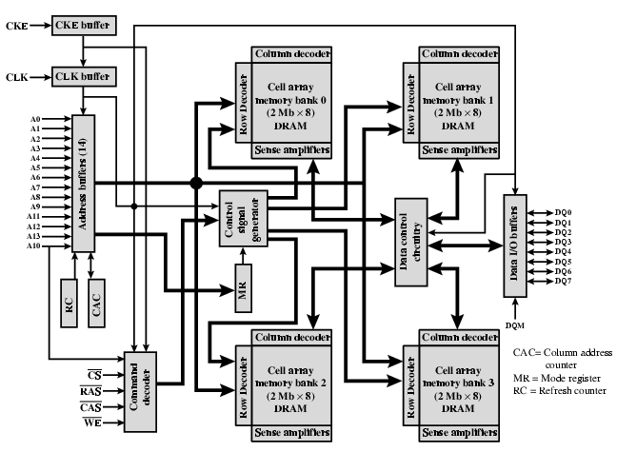
IBM 64Mb SDRAM

Slide 41
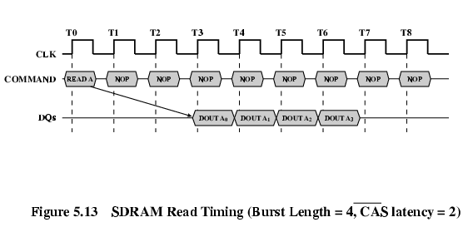
SDRAM Operation

Slide 42
RAMBUS
Adopted by Intel for Pentium & Itanium
Main competitor to SDRAM
Vertical package – all pins on one side
Data exchange over 28 wires < cm long
Bus addresses up to 320 RDRAM chips at 1.6Gbps
Asynchronous block protocol
  480ns access time
  Then 1.6 Gbps

Slide 43
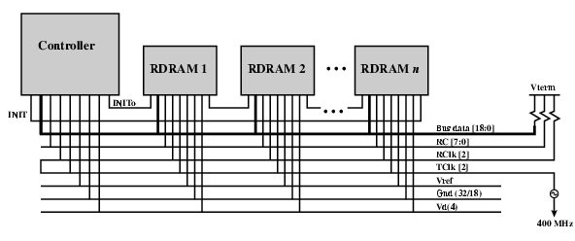
RAMBUS Diagram

Slide 44


Thank you for
your listening !

